Slide 1
RIDE SAFE:Enhancing Motorcycle Safety
PIP104 University Project-II
Review-2
Batch Number:ECM-G04
Roll Number | Student Name
20201ECM0012 | Pratiksha R Murthy
20201ECM0032 | Cherisshma KC
20201ECM0011 | Abhishek D
20201ECM0024 | Reuben B
20201ECM0030 | Mita R
Under the Supervision of,
Dr. Kokila S
School of Computer Science & Engineering
Presidency University

Slide 2
IMPLEMENTATION
#include <SoftwareSerial.h>
#include "Adafruit_FONA.h"
#define FONA_RX 4
#define FONA_TX 5
#define FONA_RST 6
#define FONA_RI_INTERRUPT 0
SoftwareSerial fonaSS = SoftwareSerial(FONA_TX, FONA_RX);
Adafruit_FONA fona = Adafruit_FONA(FONA_RST);

Slide 3
char PHONE_1[21] = "8050735728"; // Enter your Number here.
char theftalertmessage[141]= "Accident Detected" ;
int pirsensor = 0;
void setup()
{
pinMode(8,INPUT);
Serial.begin(9600);

Slide 4
Serial.println(F("Initializing....(May take 3 seconds)"));
Serial.println(F("Initializing....(May take 12 seconds)"));
delay(5000);
fonaSS.begin(9600); // if you're using software serial
if (! fona.begin(fonaSS)) { // can also try fona.begin(Serial1)
Serial.println(F("Couldn't find FONA"));
while (1);
}
fona.print ("AT+CSMP=17,167,0,0\r");
Serial.println(F("FONA is OK"));
}

Slide 5
void loop(){
int pirsensor = digitalRead(8);
Serial.print("Sensor Value:");
Serial.println(pirsensor);
if(pirsensor==1)
{
Serial.println("accident ");
make_multi_call();
send_multi_sms();
}
else
{
pirsensor = 0;

Slide 6
Serial.println("Safe");
}
}
void send_multi_sms()
{
if(PHONE_1 != ""){
Serial.print("Phone 1: ");
fona.sendSMS(PHONE_1,theftalertmessage);
delay(20000);
}
}

Slide 7
void make_multi_call()
{
if(PHONE_1 != ""){
Serial.print("Phone 1: ");
make_call(PHONE_1);
delay(5000);
}
}
void make_call(String phone)
{
Serial.println("calling....");
fona.println("ATD"+phone+";");

Slide 8
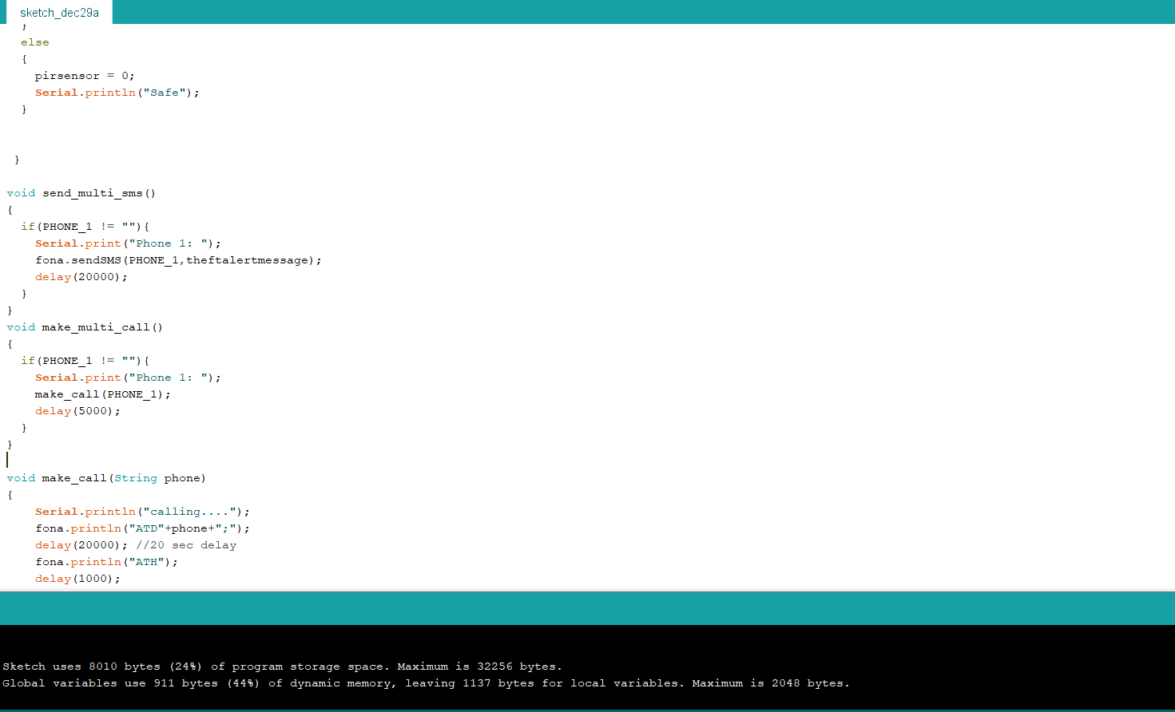
delay(20000); //20 sec delay
fona.println("ATH");
delay(1000);
}

Slide 9
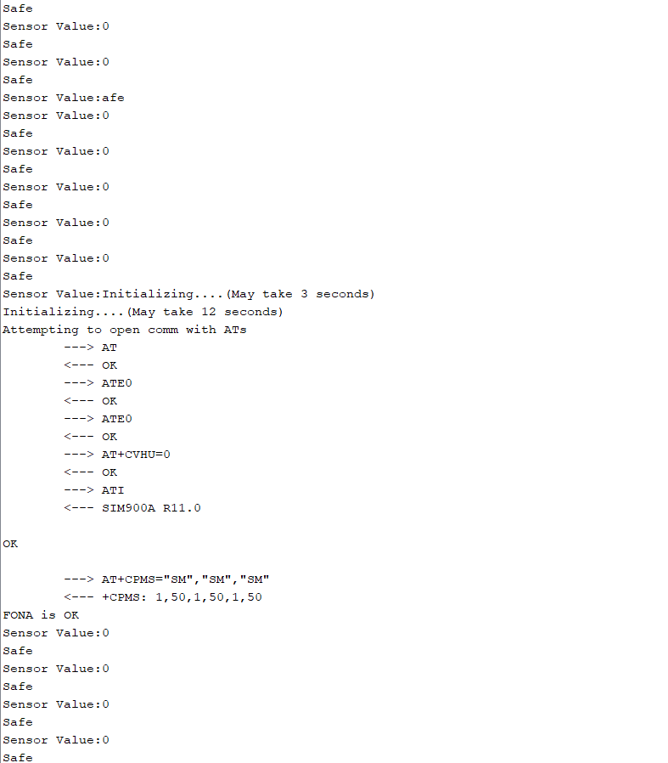
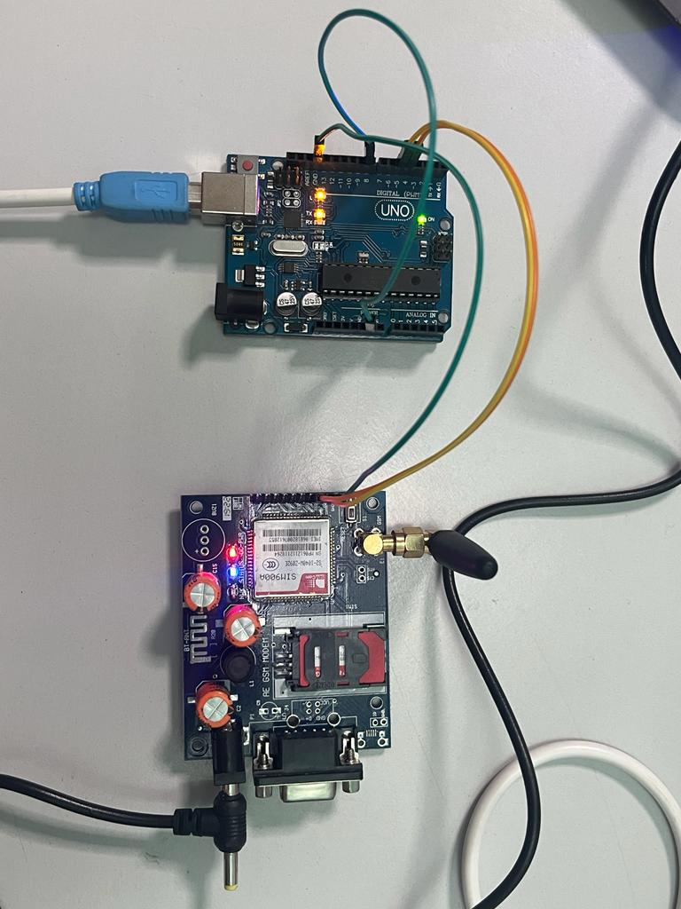

Slide 10
Thank You

